Slide 1
Business Solutions for Recruitment Offices
By : Mohammed Alosaimi

Slide 2
Identify Business Problem
Data Collection and Cleaning
Feature Engineering
Business Solution
Improving Business Decisions
Challenges
Future Works and Live Demo
Agenda

Slide 3
Statistics
63,723 foreign domestic workers
1.4 million house drivers.
Resource: http://saudigazette.com.sa/article/534105

Slide 4
Recruit a worker
Identify Business Problems
Replace a worker
Cost money

Slide 5
Identify Business Problems
Question!
What is the probability that a worker from a certain country would be a good option for the client based on his/her information and their request specifications?
What are the countries that make more profit in a certain month?

Slide 6


Data Collection and Data Cleaning

Slide 7
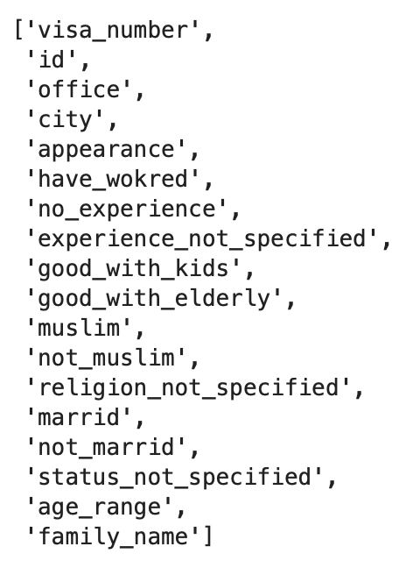
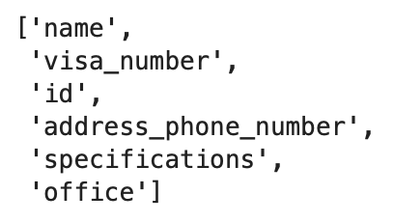
Feature Engineering

Slide 8
Business Solution
Predict probability
03
Predict Countries
01
02
Clustering

Slide 9
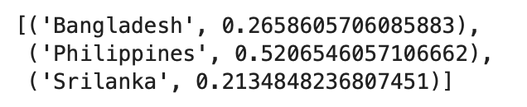
Predict Probability

Slide 10
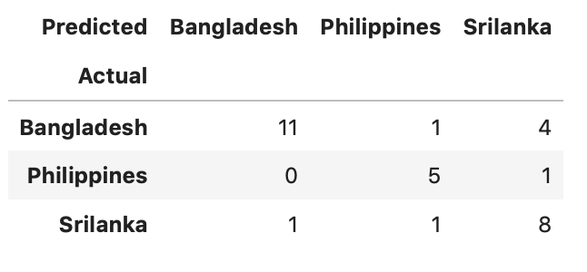
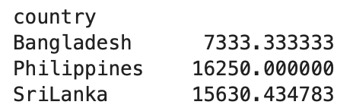
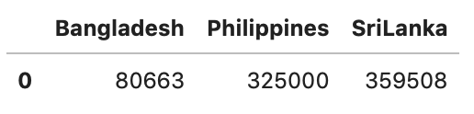
Predict Countries
Predict how many request for each country in a given month
Income mean
Sum of our predicted Income: 765,171
Sum of Income: 446500.0

Slide 11
Clustering and some insights of the data

Slide 12
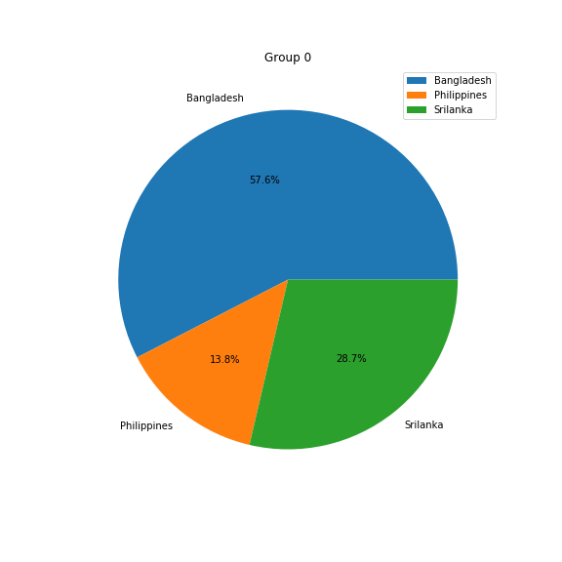
Average age requested: 30
City: Riyadh
Family name: Alonazi

Slide 13
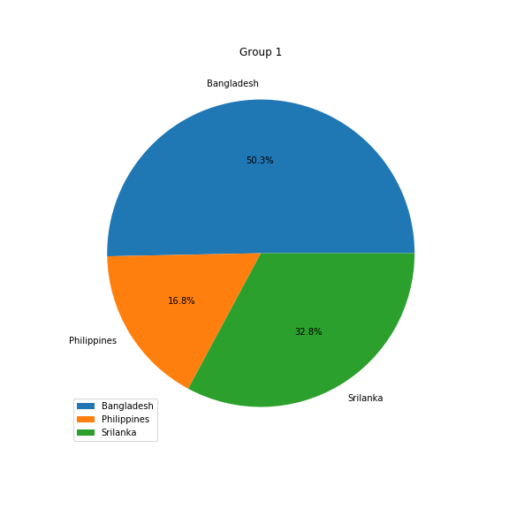
Average age requested: 30
City: Abha
Family name: Alotaibi

Slide 14
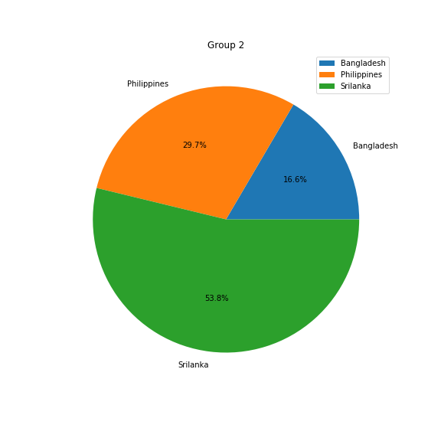
Average age requested: 35
City: Riyadh
Family name: Almutairi

Slide 15
Making Better Business Decisions
Build a web application
Show Probability
Link predictions to the profit data
1
2
3

Slide 16
Insight of the Data

Slide 17
Challenges
Lack of observations in the data
03
Dirty Data
01
02
Lack of communications with the service provider

Slide 18
Future Works
Advice the service provider to refine their data collection process.
Integrate data collection system into my web application
Advise the service provider to collect more descriptive data

Slide 19
Live Demo

Slide 20
Thank You For Listening

